Slide 1
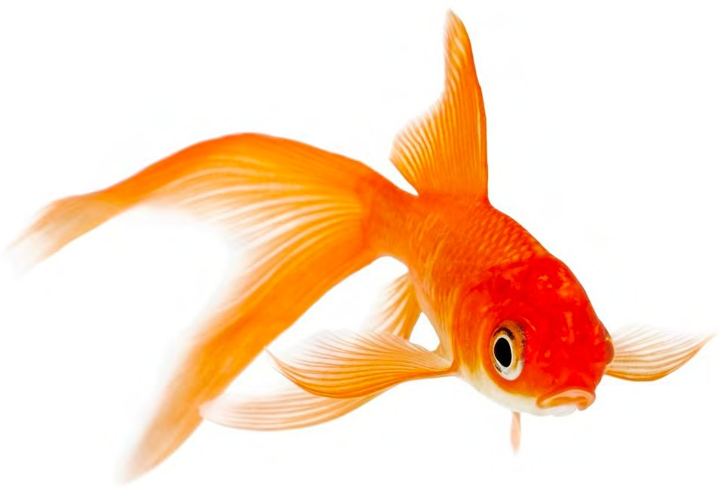

Attention in Deep Learning
Alex Smola (smola@) and Aston Zhang (astonz@)
Amazon Web Services ICML 2019, Long Beach, CA
bit.ly/2R10hTu alex.smola.org/talks/ICML19-attention.key
©alex.smola.org/talks/ICML19-attention.pdf
2019, Amazon Web Services, Inc. or its Affiliates. All rights reserved.

Slide 2
Outline
Watson Nadaraya Estimator
Pooling
Single objects - Pooling to attention pooling
Hierarchical structures - Hierarchical attention networks
Iterative Pooling
Question answering / memory networks
Iterative Pooling and Generation
Neural machine translation
Multiple Attention Heads
Transformers / BERT
Lightweight, structured, sparse
6. Resources
d2l.ai

Slide 3
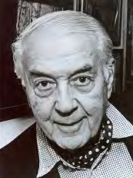
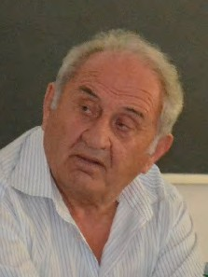
1. Watson Nadaraya Estimator ‘64
Geoffrey Watson
Elizbar Nadaraya
d2l.ai

Slide 4
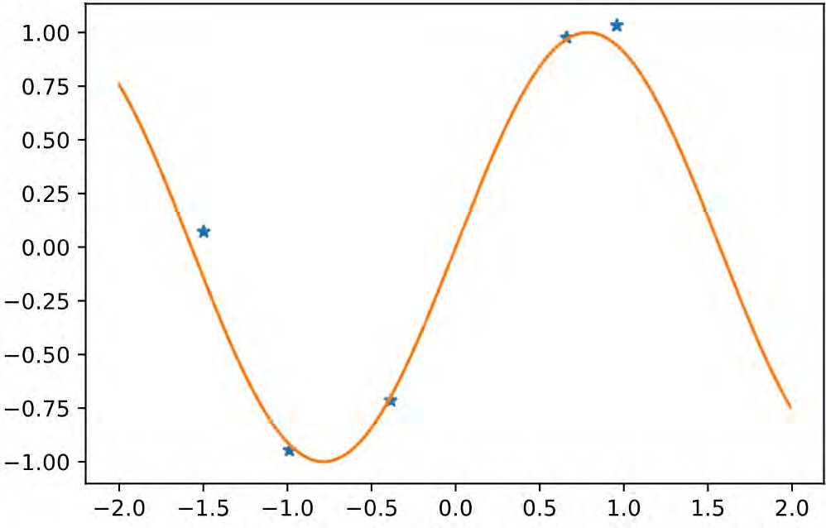
Regression Problem
d2l.ai

Slide 5
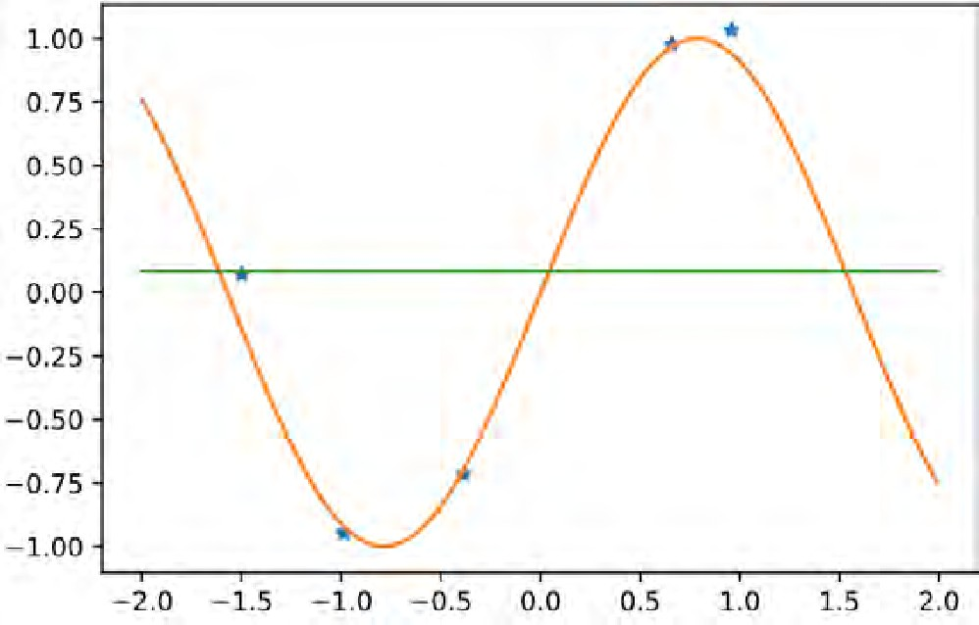
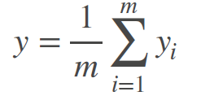
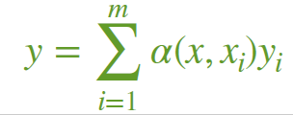
Solving the regression problem
Data {x₁, …x_{m}} and labels {y₁, …y_{m}}
Estimate label y at new location x
The world’s dumbest estimator
Average over all labels
Better idea (Watson, Nadaraya, 1964)
Weigh the labels according to location
d2l.ai

Slide 6



Solving the regression problem
Data {x₁, …x_{m}} and labels {y₁, …y_{m}}
Estimate label y at new location x
The world’s dumbest estimator
Average over all labels
Better idea (Watson, Nadaraya, 1964)
Weigh the labels according to location
key
α(x, x_{i})y_{i}
query
value
d2l.ai

Slide 7
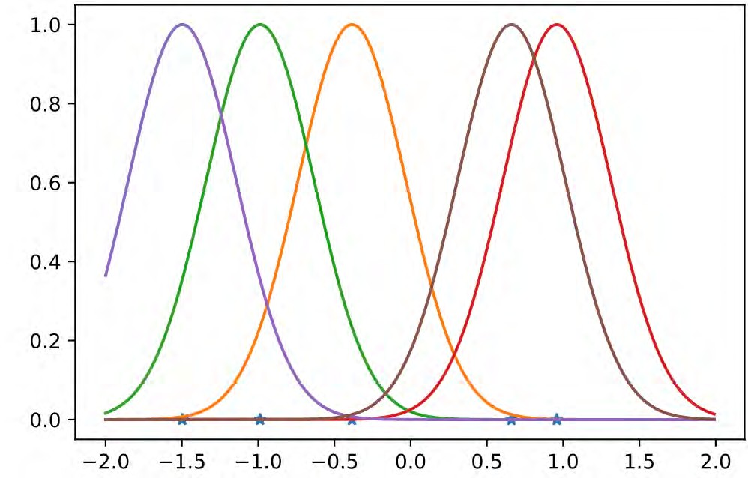

Weighing the locations (e.g. with Gaussians)
not normalized
α(x, x_{i}) ∝ k(x_{i}, x)
d2l.ai

Slide 8
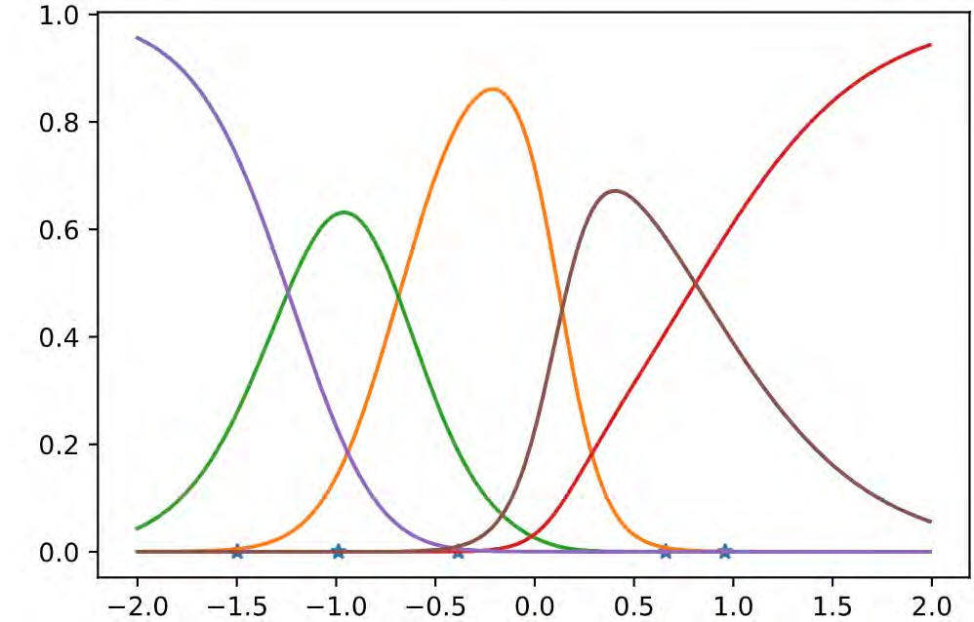

Weighing the locations (e.g. with Gaussians)
normalized
k(x_{i}, x)
∑_{j} k(x_{j}, x)
α_{i}(x) =
d2l.ai

Slide 9
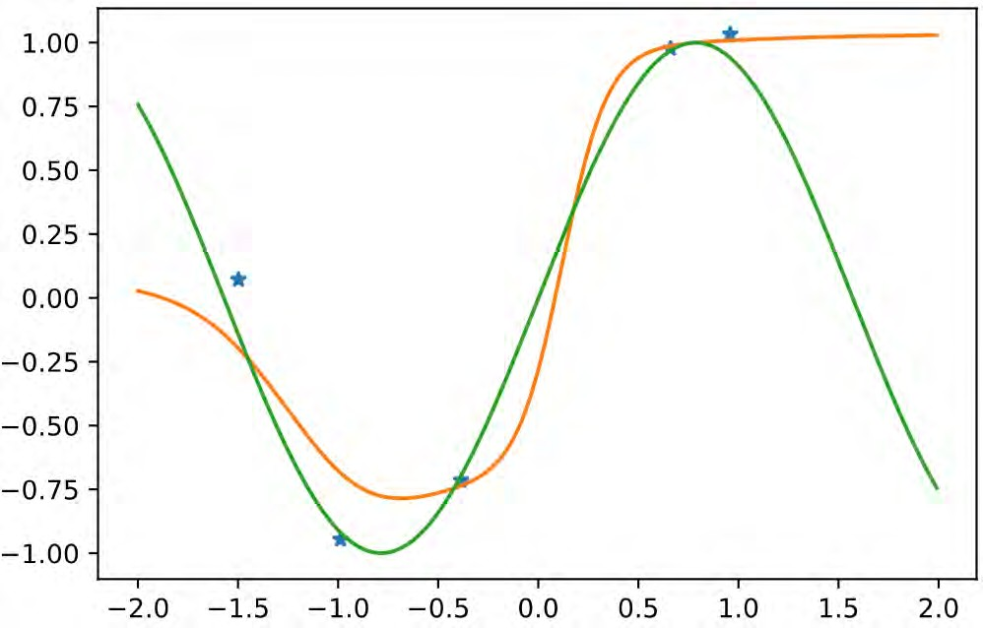
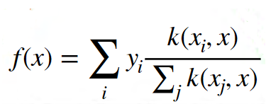
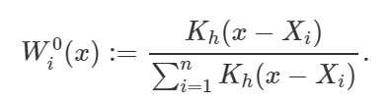
Weighted regression estimate
Wi(x)
d2l.ai

Slide 10
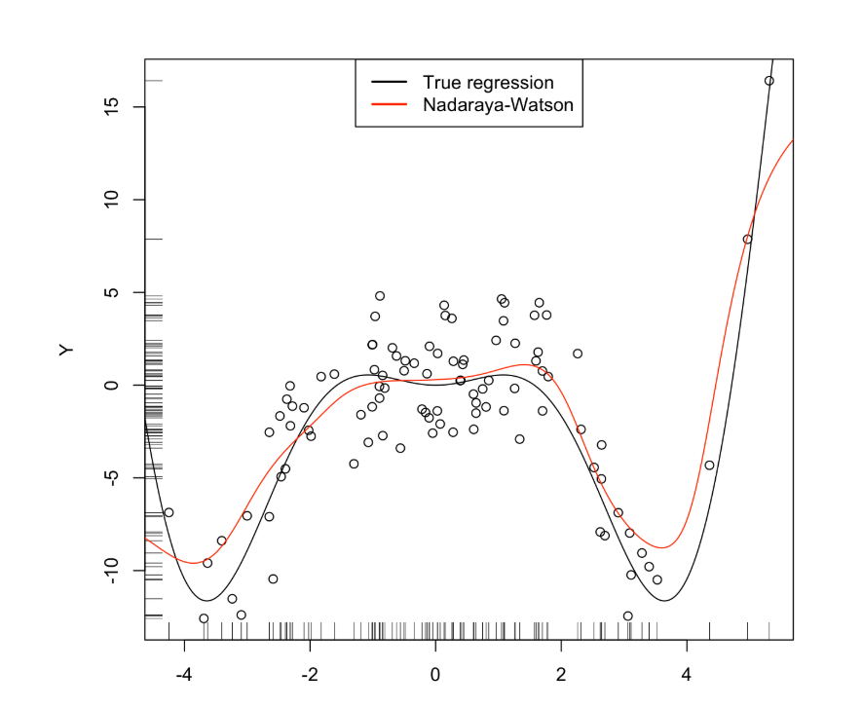

Slide 11
Why bother with a 55 year old algorithm?
Consistency
Given enough data this algorithm converges to the optimal solution (can your deep net do this?)
Simplicity
No free parameters - information is in the data not weights (or very few if we try to learn the weighting function)
• Deep Learning Variant
• Learn weighting function
• Replace averaging (pooling) by weighted pooling
d2l.ai

Slide 12
Why bother with a 55 year old algorithm?
Consistency
Given enough data this algorithm converges to the optimal solution (can your deep net do this?)
Simplicity
No free parameters - information is in the data not weights (or very few if we try to learn the weighting function)
Deep Learning Variant
Learn weighting function
Replace averaging (pooling) by weighted pooling
d2l.ai

Slide 13

2. Pooling
d2l.ai

Slide 14
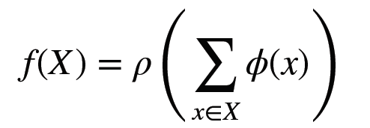
Deep Sets (Zaheer et al. 2017)
Deep (Networks on) Sets X = {x₁, …x_{n}}
Need permutation invariance for elements in set (e.g. LSTM doesn’t work to ingest elements)
Theorem - all functions are of the form*
*or some combination thereof
Applications - point clouds, set extension, red shift for galaxies, text retrieval, tagging, etc.
d2l.ai

Slide 15
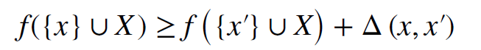
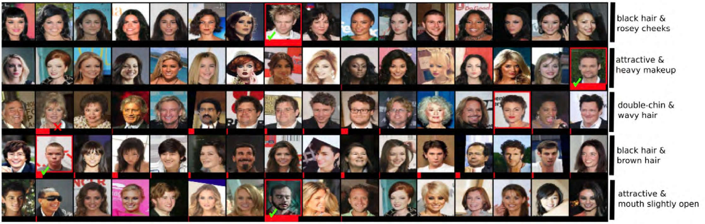

Deep Sets (Zaheer et al. 2017)
Outliers in sets - learn function f(X) on set such that
d2l.ai

Slide 16
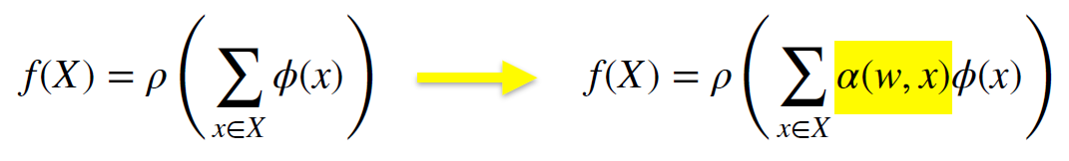
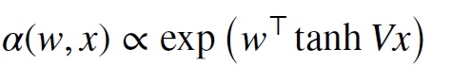
Deep Sets with Attention aka
Multi-Instance Learning (Ilse, Tomczak, Welling, ’18)
Multiple Instance Problem
Set contains one (or more) elements with desirable property (drug discovery, keychain). Identify those sets.
Deep Sets have trouble focusing, hence weigh it
Attention function e.g.
d2l.ai

Slide 17
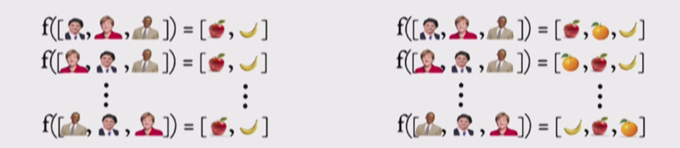
Deep Sets

Slide 18
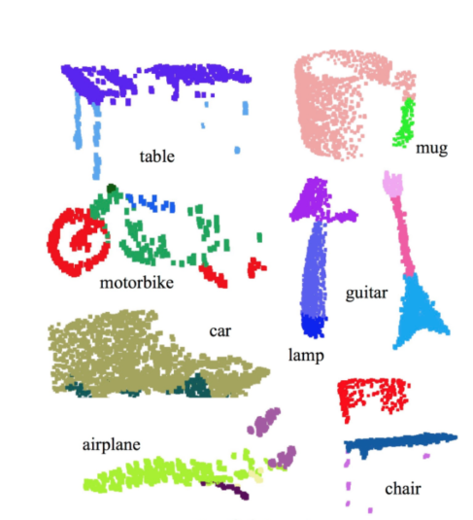
point clouds

Slide 19
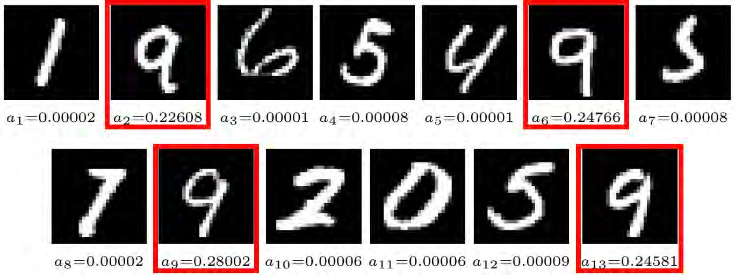
Deep Sets with Attention aka
Multi-Instance Learning (Ilse, Tomczak, Welling, ’18)
Identifying sets that contain the digit ‘9’
d2l.ai

Slide 20
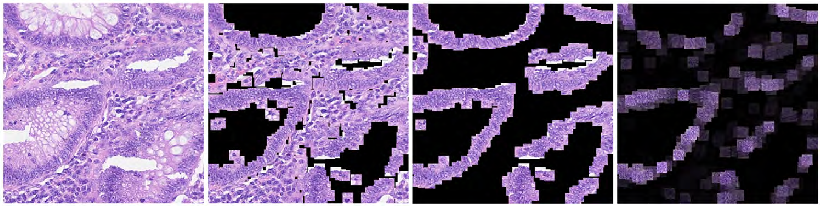
Deep Sets with Attention aka
Multi-Instance Learning (Ilse, Tomczak, Welling, ’18)
tissue sample
windowed cell nuclei
cancerous cells
attention weights
d2l.ai

Slide 21
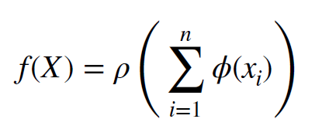

Bag of words (Salton & McGill, 1986) Word2Vec (Mikolov et al., 2013)
Embed each word in sentence (word2vec, binary, GRU …)
Add them all up
Classify
The tutorial is awesome.
+ + +
d2l.ai

Slide 22
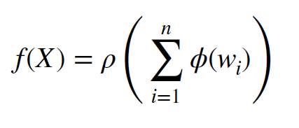
Bag of words (Salton & McGill, 1986) Word2Vec (Mikolov et al., 2013)
Embed each word in sentence (word2vec, binary, GRU …)
Add them all up
Classify
Alex is obnoxious but the tutorial is awesome.
+ + + + + + +
d2l.ai

Slide 23
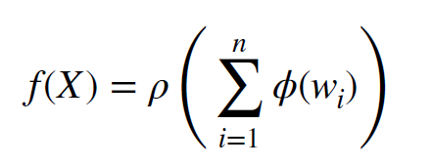
Bag of words (Salton & McGill, 1986) Word2Vec (Mikolov et al., 2013)
Embed each word in sentence (word2vec, binary, GRU …)
Add them all up
Classify
Alex is obnoxious but the tutorial is awesome.
+
+
+
+
+
+
+
ignore this
d2l.ai

Slide 24
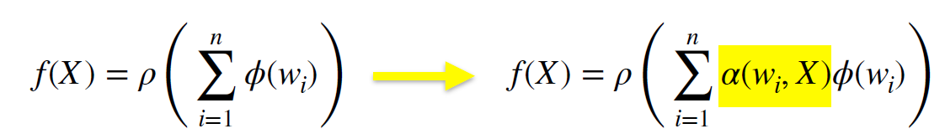
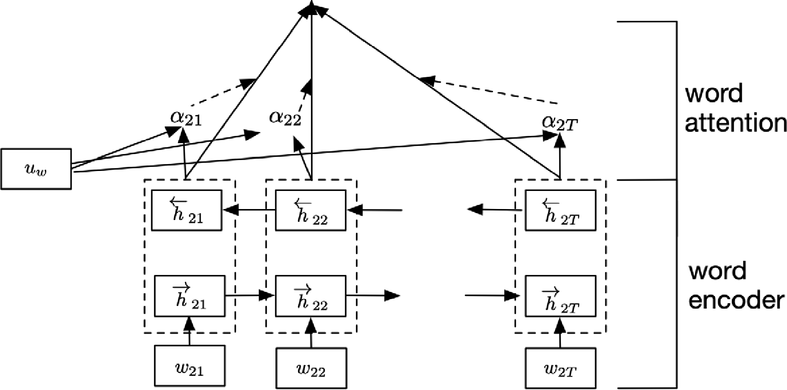

Attention weighting for documents (Wang et al, ’16)
d2l.ai

Slide 25
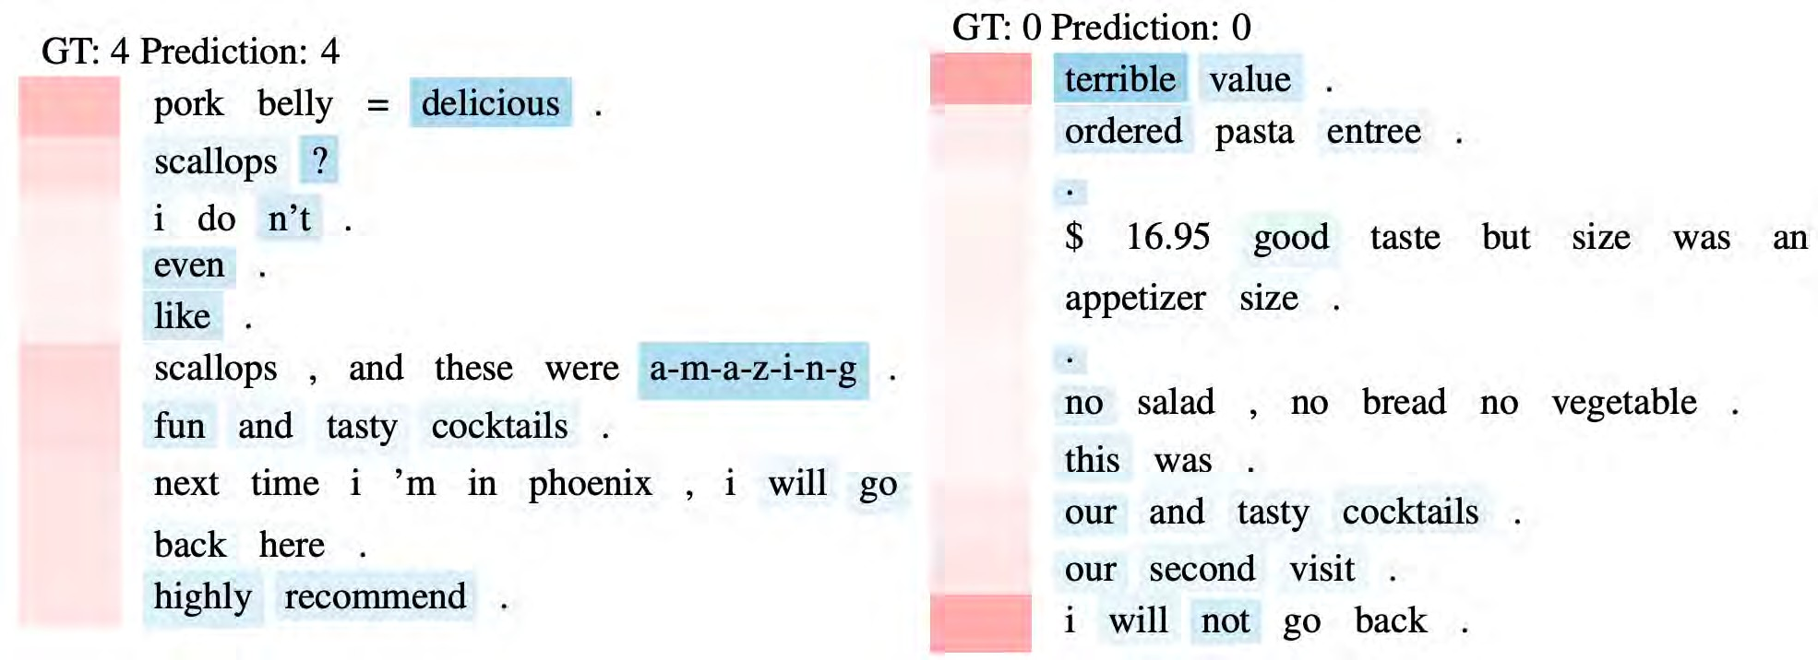
Hierarchical attention weighting (Yang et al. ’17)
Some sentences are more important than others …
d2l.ai

Slide 26
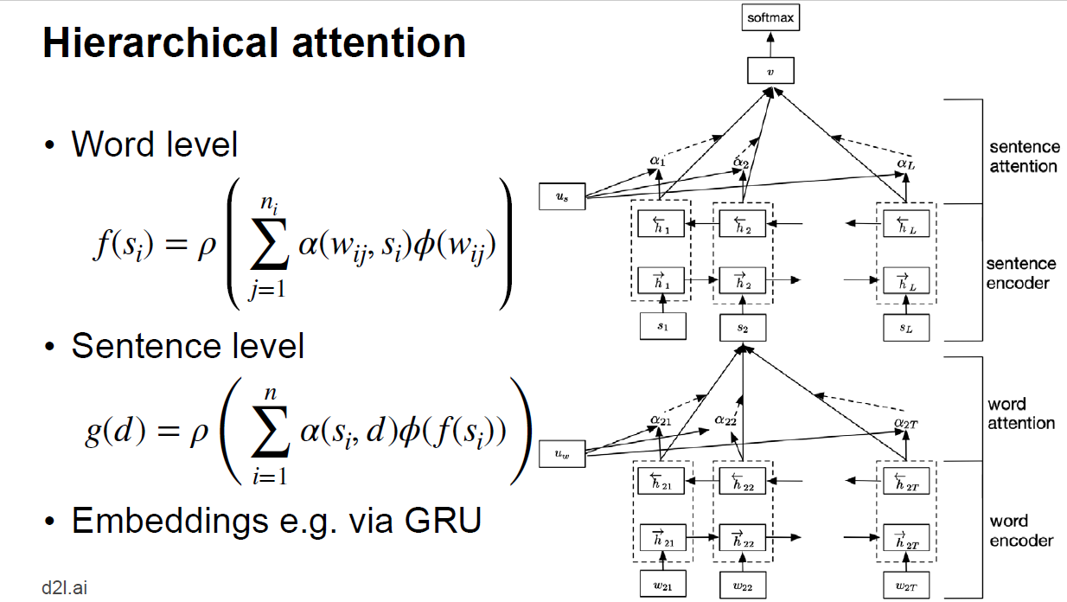
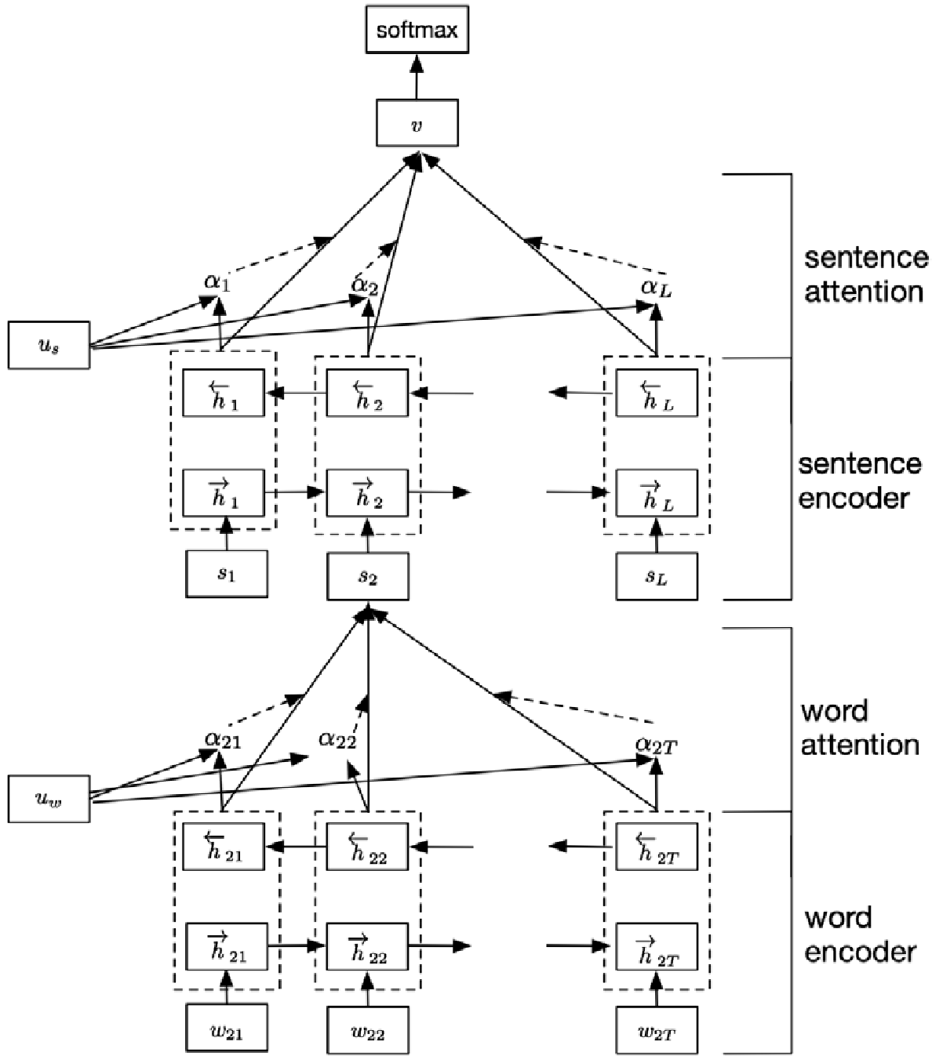
Hierarchical attention
Word level
Sentence level
Embeddings e.g. via GRU
d2l.ai

Slide 27
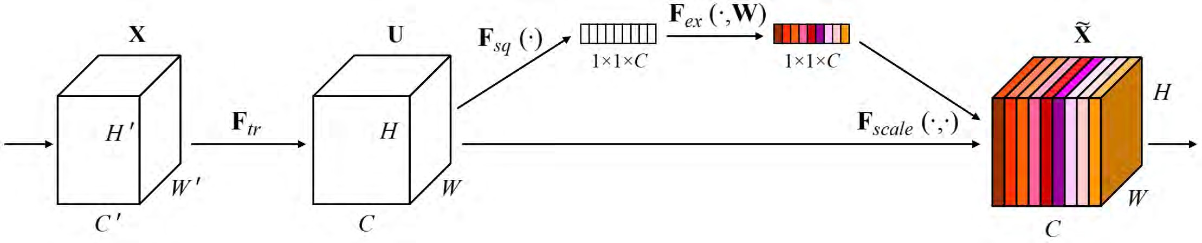
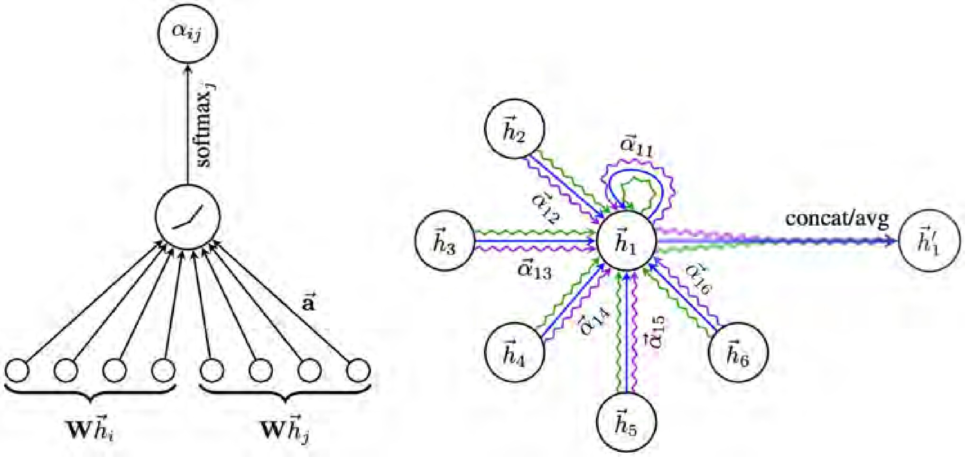
More Applications
Squeeze Excitation Networks (Hu et al., ’18)
(W,H) : 圖像的尺寸
C : 圖像的通道數
Feature map
Graph Attention Networks
(Velickovic et al., ’18)
d2l.ai

Slide 28
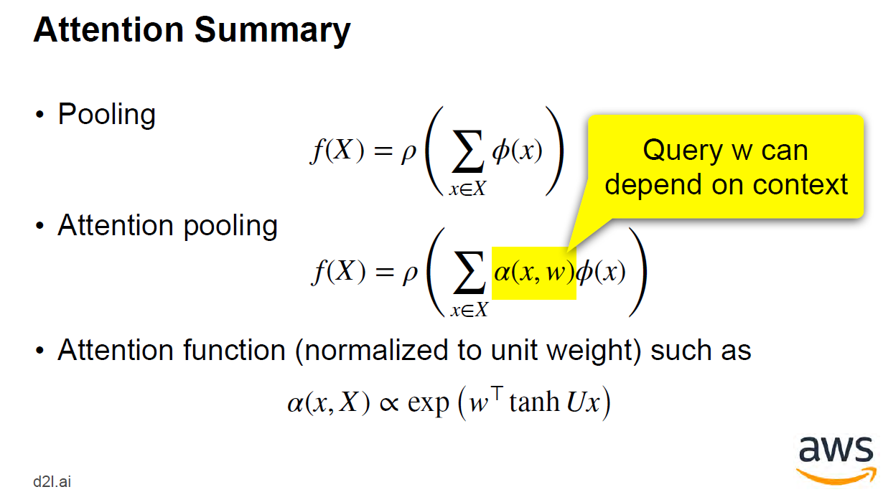

Attention Summary
Pooling
f(X) = ρ
ϕ(x)
Query w can depend on context
(
(
∑
)
x∈X
Attention pooling
f(X) = ρ
α(x, w)ϕ(x)
∑
)
x∈X
Attention function (normalized to unit weight) such as
α(x, X) ∝ exp ₍w⊤ tanh Ux₎
d2l.ai

